Slide 1
KNOWLEDGE GRAPH
SUMMARIZATION

Slide 2
Group Members
Shreyas Kottur Shivananda
Pavan Kumar Sheshanarayana
Muhammad Haseeb Javaid
Ammar Mustafa
Usman Ashraf

Slide 3
Problem Statement
Problem: Enormous amounts of data provided as graphs
Requirement: Reduction of Graph size
Proposed Solution: Graph Summarization

Slide 4
Approach
Handle User Input
Fetch Data as Triples
Graph Construction
Ranking Algorithm
Graph Summarization
View/Download Graph

Slide 5
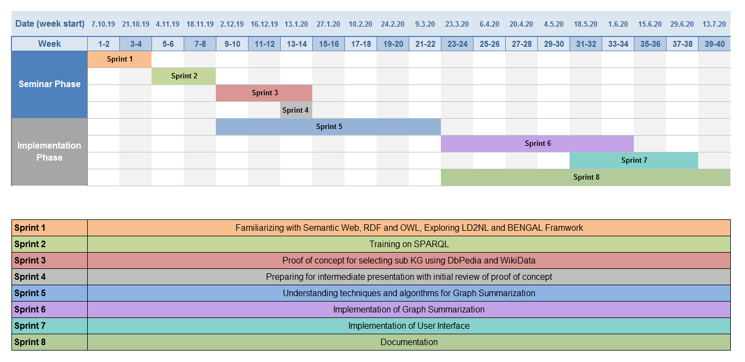
TimeLine

Slide 6
Technologies
Java
SPARQL
Spring Boot Framework
Apache Jena
Git ( For code base maintenance )

Slide 7
POC - Breakdown
Querying DBpedia
Fetching Triples
Graph Construction
Page Rank Algorithm
Graph Expansion
Page Rank / top k nodes
Deployment as Web Service

Slide 8
We learned…
RDFs and their principles
Triples and their use to create RDFs.
SPARQL.
Apache Jena and the triples creation.
Page Rank Algorithm.

Slide 9
Challenges Faced
Processing of huge data set.
False positives of entities.

Slide 10
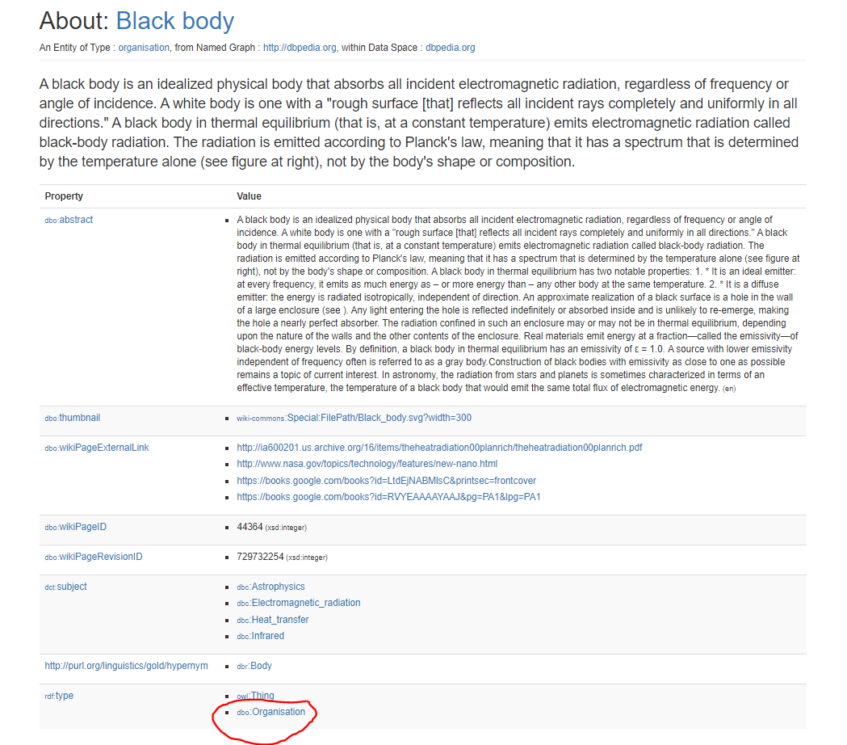

Slide 11
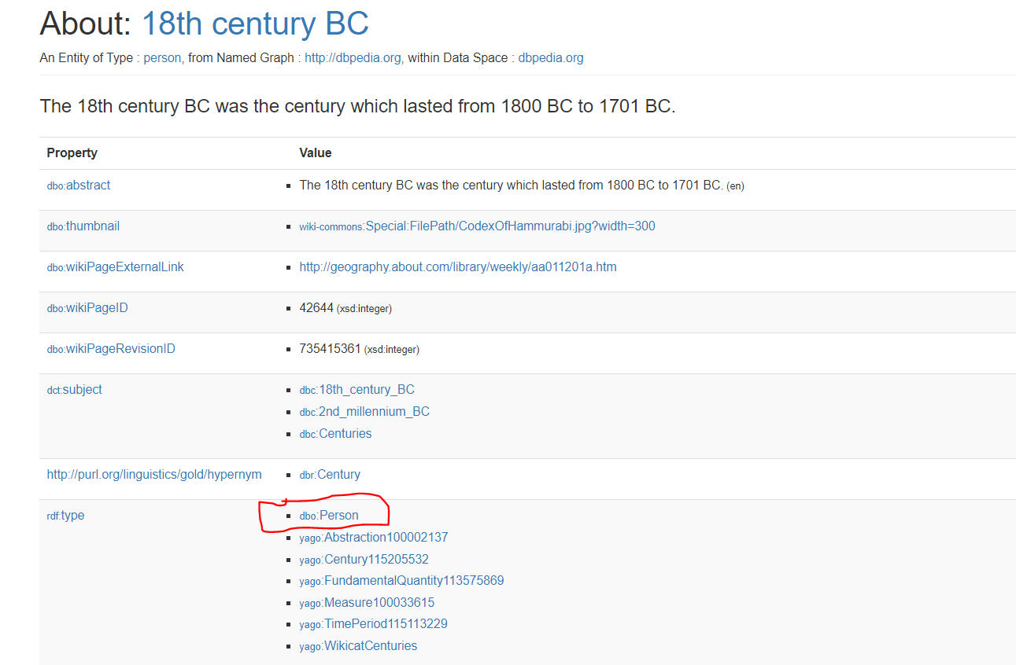

Slide 12
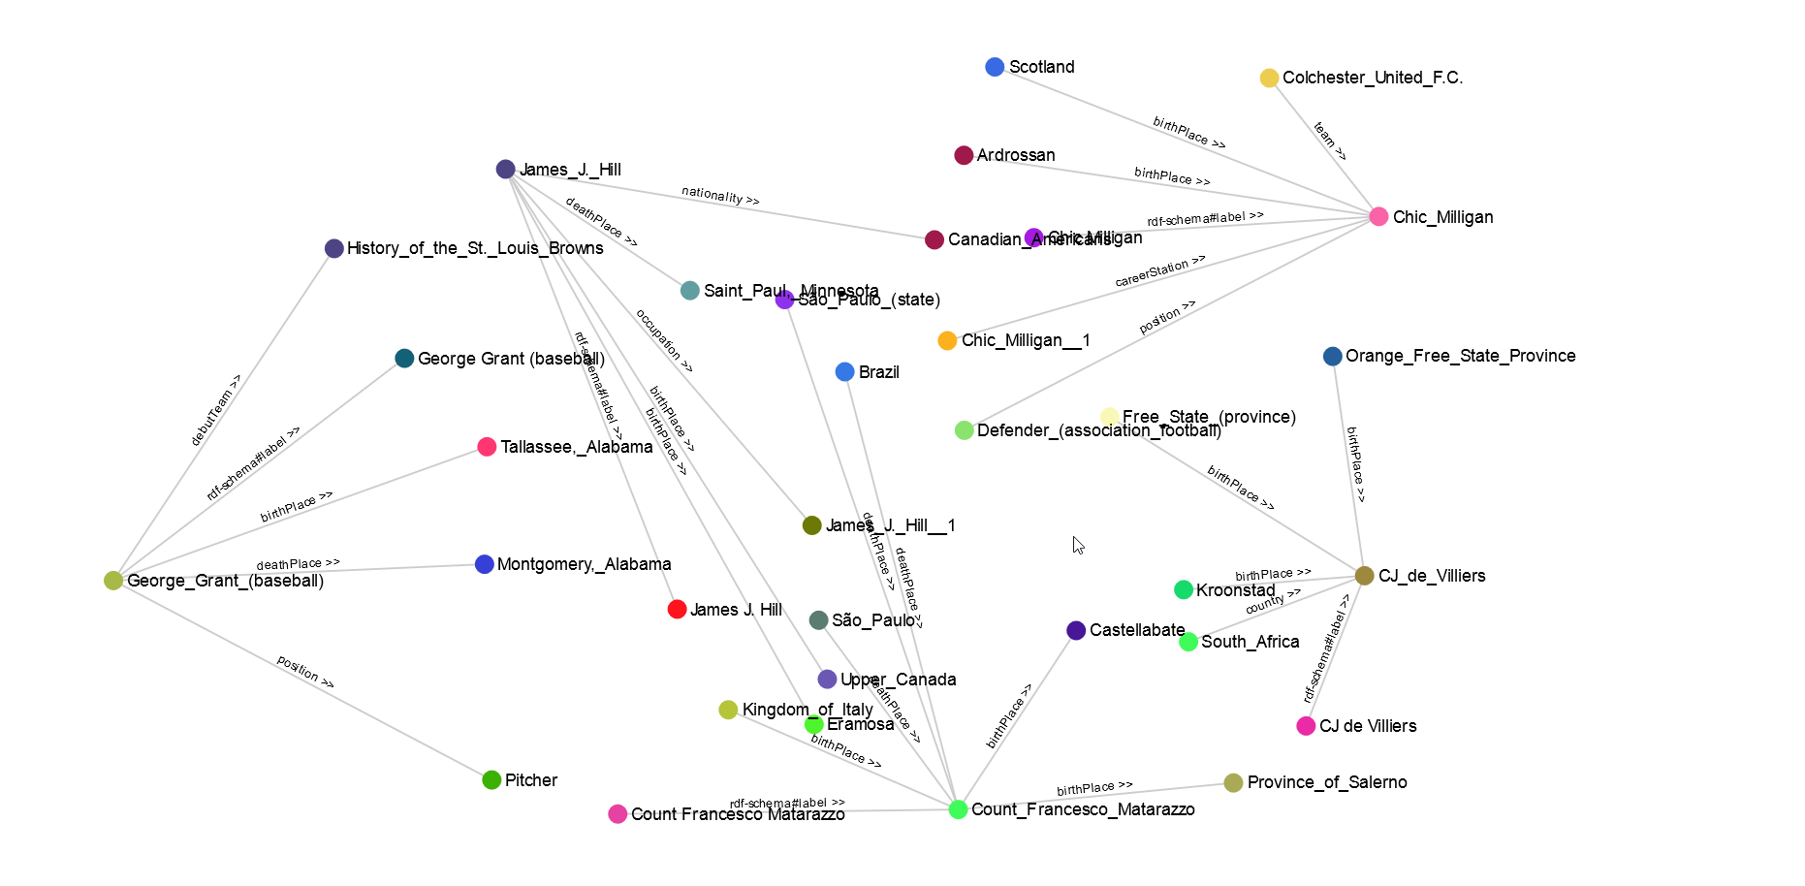
Person Class with top 5 entities

Slide 13
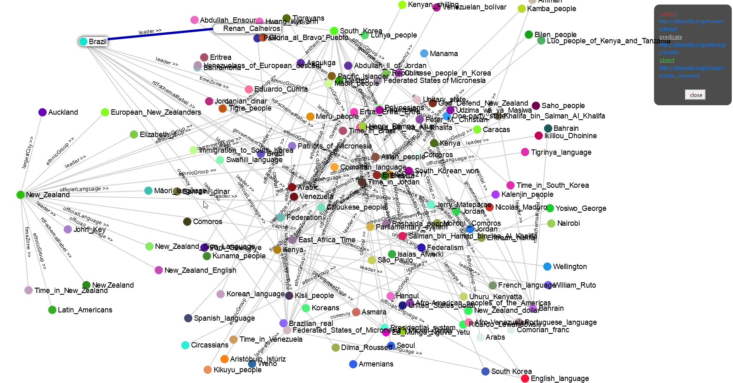
Country Class with top 10 entities

Slide 14
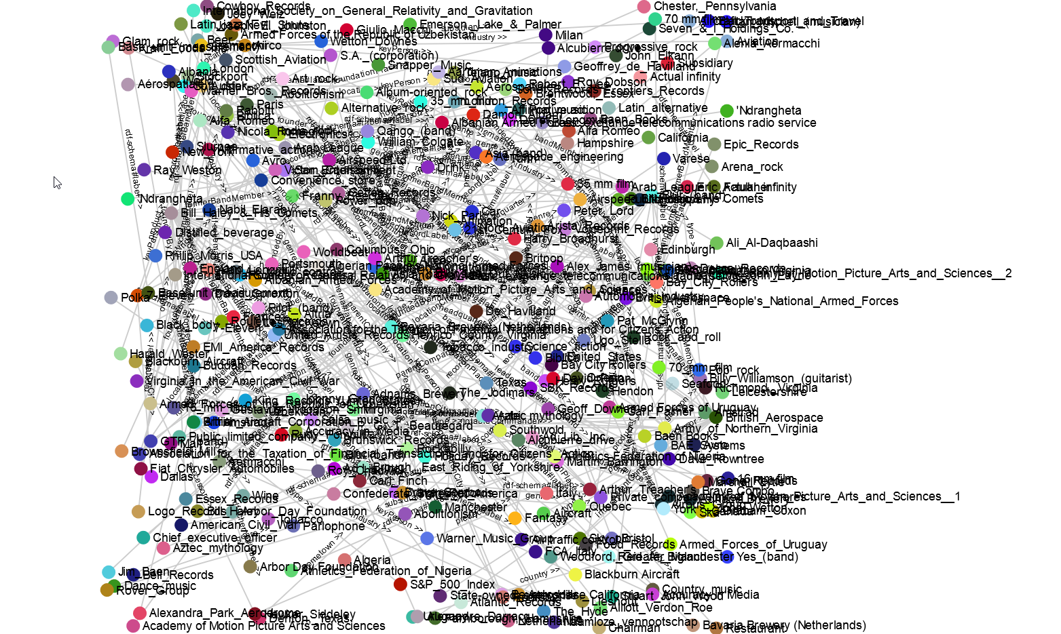
Organization Class with top 50 entities

Slide 15
Current Status
Successfully completed all the steps in the POC.
Researching Graph Summarization Algorithms.
Some algorithms are:
HITS(Hyper Induced Topics Search)
LinkSum
SALSA(Stochastic Approach for Link-Structure Analysis)

Slide 16

Algorithms
HITS

Slide 17
Algorithms
HITS
Authoritative nodes and hubs.
Authority weights and hub weights.
High rank authorities pointed by high rank hubs.
High rank hubs point to many high rank authoritative nodes.
SALSA
Similar to HITS and PageRank.
Differ in mutually reinforcing relationship compared to HITS.
Computes ranking similar to PageRank but on hubs and authority nodes separately.

Slide 18
Algorithms
LinkSUM
Relevance oriented summarization approach.
Two key step
Resource selection
Relation selection
Resource selection is performed by combining PageRank and BackLinking algorithms.
Relation selection is performed by considering frequency, exclusivity and description.

Slide 19
Next Actions
Algorithm Comparison
Feasibility Check
Implementation
Validation
User Friendly GUI

Slide 20


Data Sources

Slide 21
Live Demo..

Slide 22
Thank You!

Slide 23
Questions?

